Slide 1
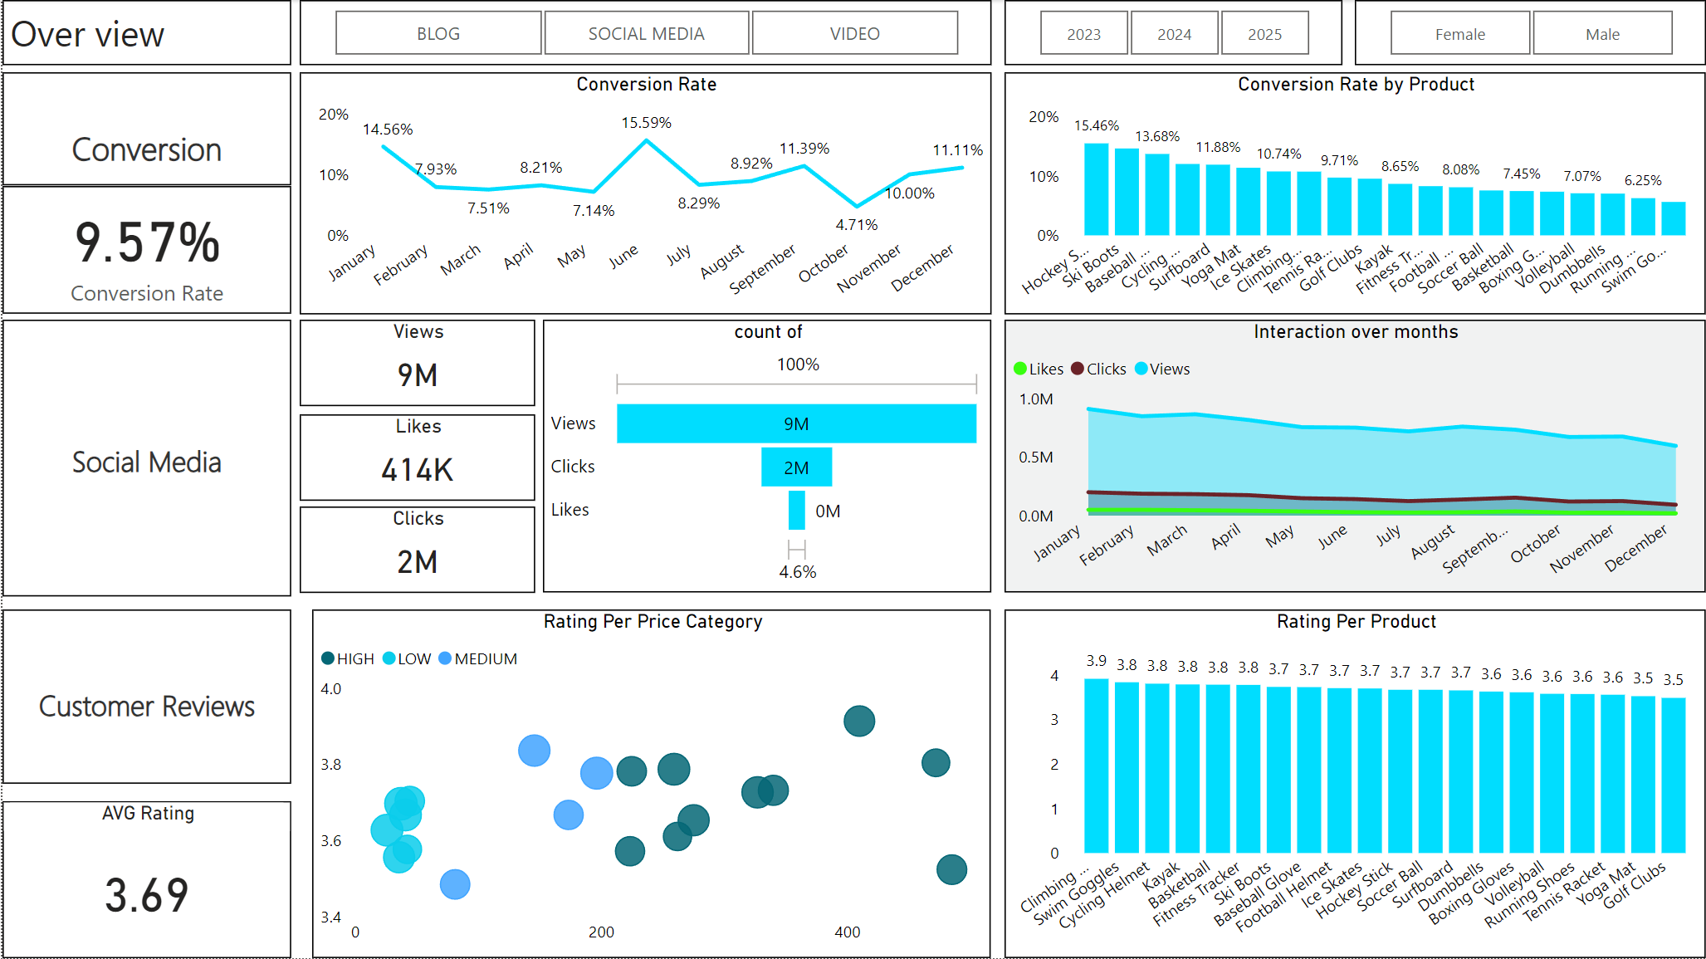
Marketing Analysis Report
By :
Adham Mohamed Mohamed labeb

Slide 2
Overview
Introduction
Data overview
SQL Cleaning
Python Cleaning
Dashboard
Insights
Goals & Actions

Slide 3
Introduction
Objective : This report aims to analyze different marketing campaign throughout different platforms (Social media , Blogs and videos) and also analyze the feedback from some customers who used our product for a sports equipment store
Tools Used : SQL , Python , Bower BI

Slide 4
Data overview
Data set size
the data base contain 6 different tables ( Customer , Customers_journey , Customer_Reviews , geography , products , Engagement _ data)
Data Coverage
The data set provides comprehensive marketing data , including key attributes such as Product name , Country , action , Rating , Customer name , Gender enabling a compact analysis of marketing campaign impact

Slide 5
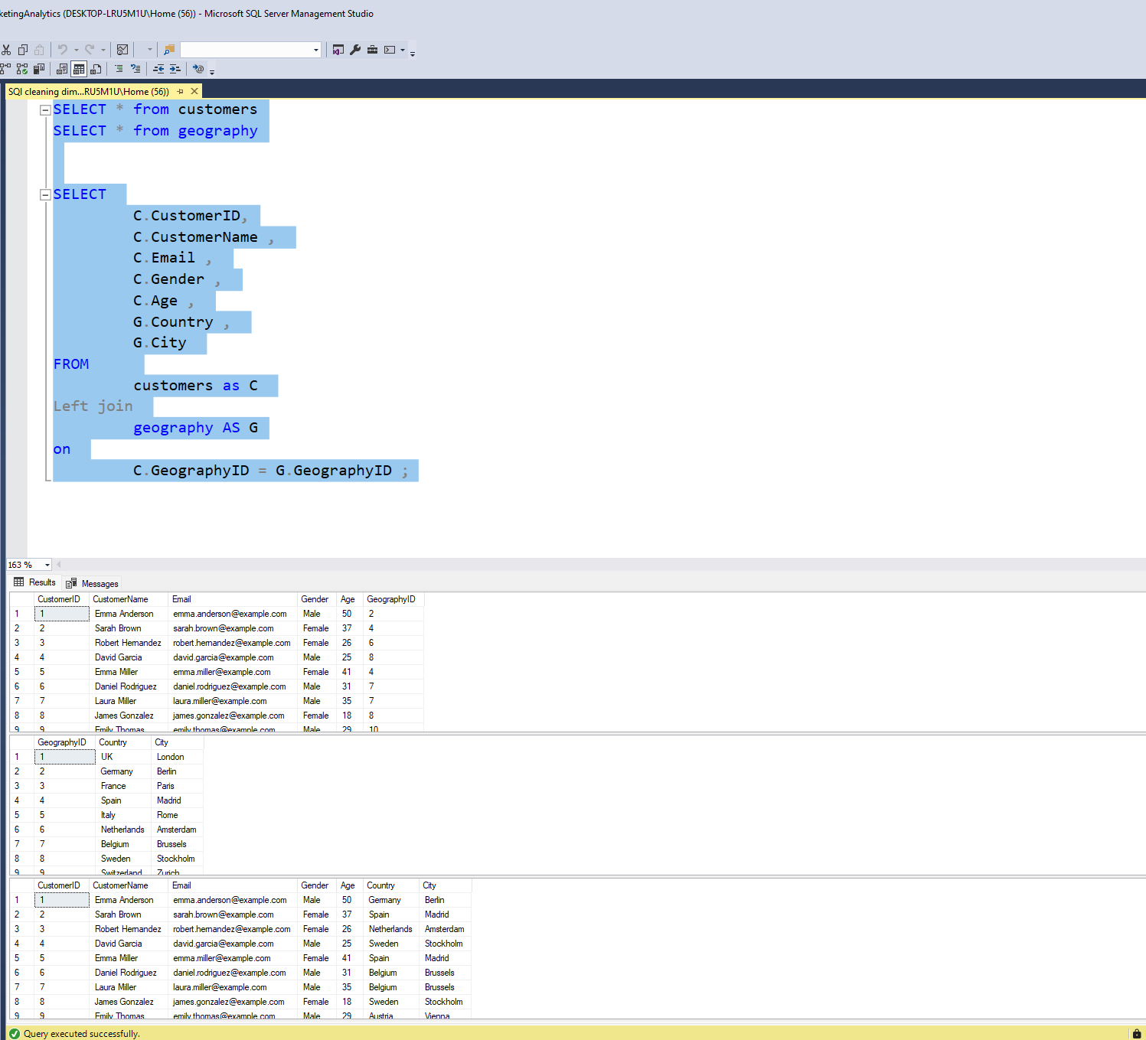
SQL Cleaning
1- customers table
In this query we joined the geography table with customers table and extract the desired column

Slide 6
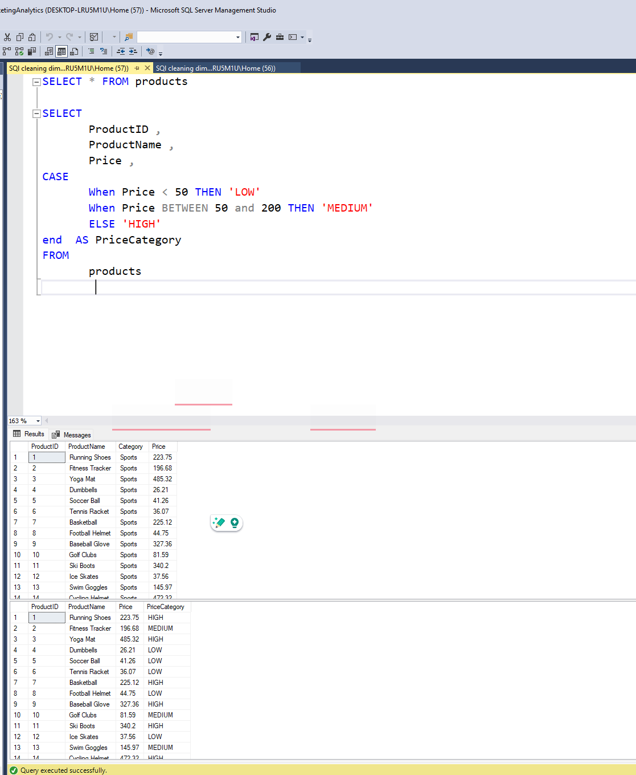
SQl cleaning
2- products table
In this query we drop the category column as we have only
one category and we added a custom column
(price category) to classify product based on price

Slide 7
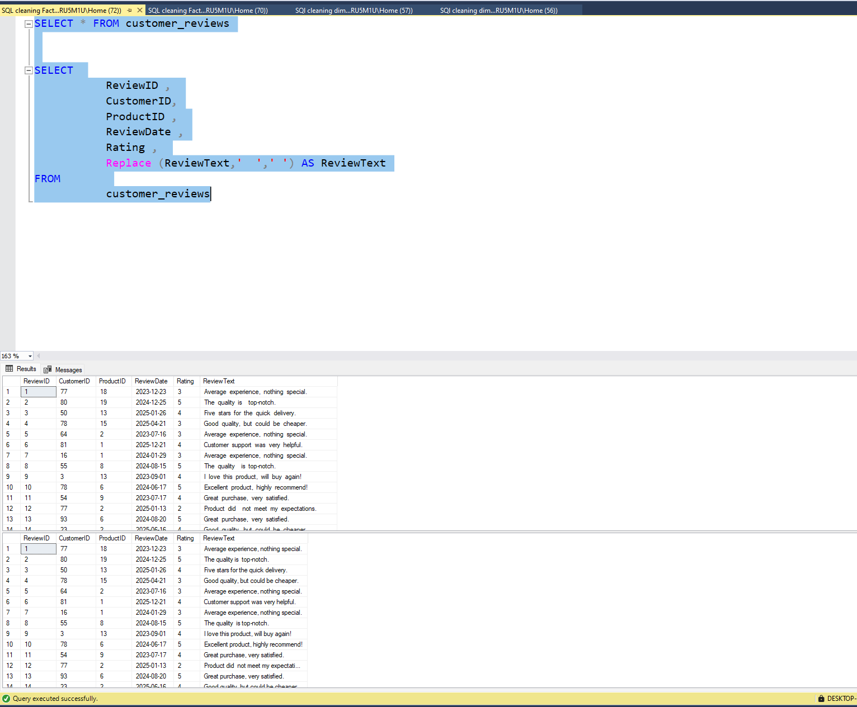
SQl cleaning
3- Customers reviews table
In this query we solve a typo error in the Review text
colmn for replacing some double spaces with only
One space

Slide 8
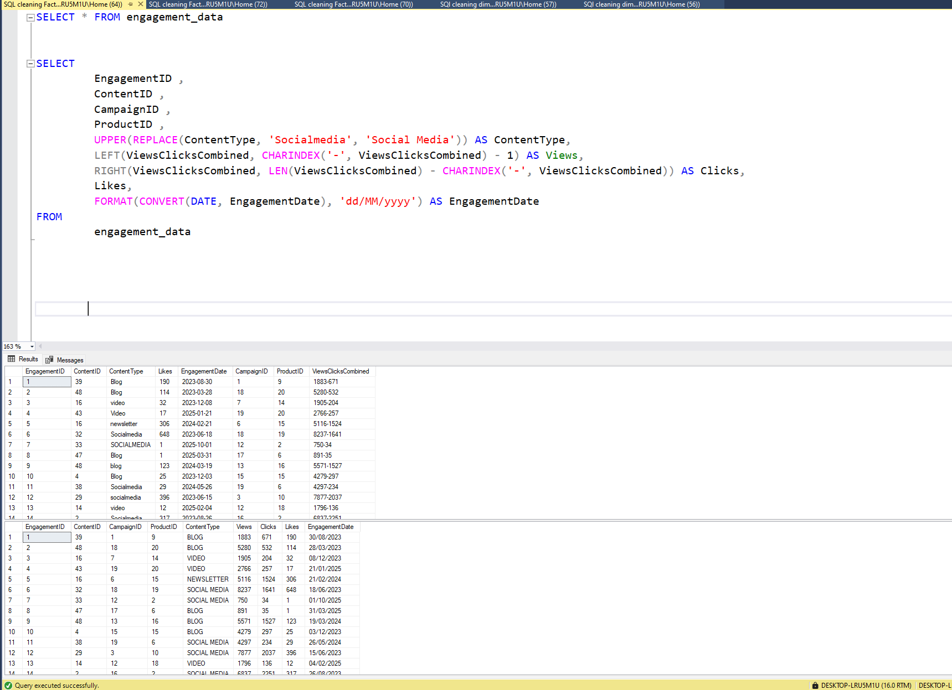
Sql cleaning
4- Engagement data table
In this query we change the content type column
To be upper case then we split the viewsclicks compined
Column into two separate column Views and clicks
based on (-)And the final step was format the
Engagement date from Year-month-day to day/month/year

Slide 9
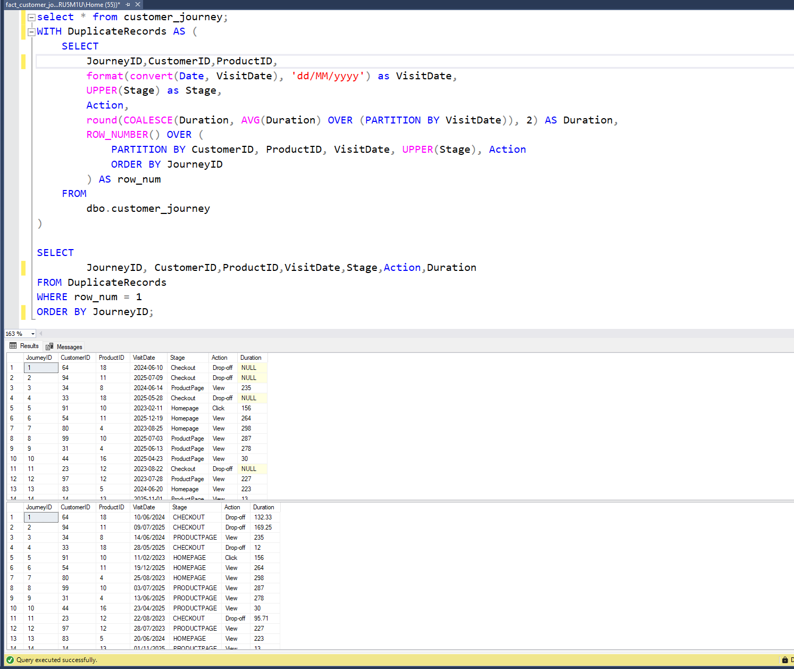
Sql cleaning
5- Customer journey table
In this query we remove the duplicates from the
Customer journey table and fill the null values
In the duration column with the avg value

Slide 10
Python cleaning
After we made some cleaning in SQL Server we found
Some problem that we can not solve in the SQL Server
So we used python to do it
1- removing the errors in the gender column in the customer table
2- adding a column to understand more about the customer review
Based on both the rating number and the rating text

Slide 11
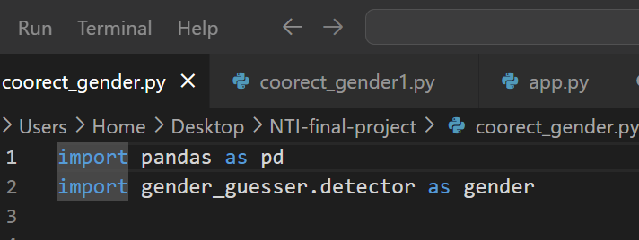
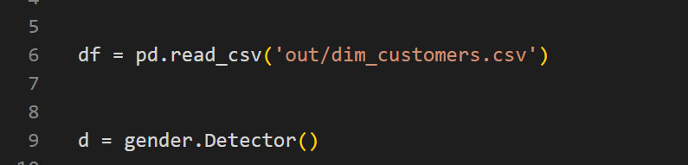
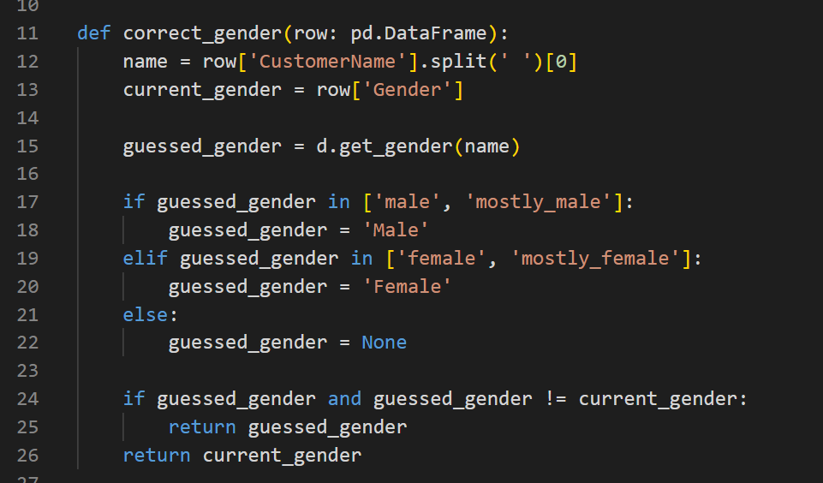
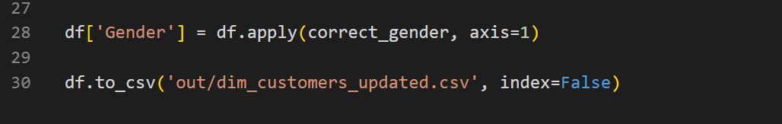
Gender correction
Importing libraries : pandas and gender_guesser
Inserting data and call the desired method from the gender_guesser library
Apply the library on the data and change the wrong gender
Present the data then save it into a CSV file

Slide 12
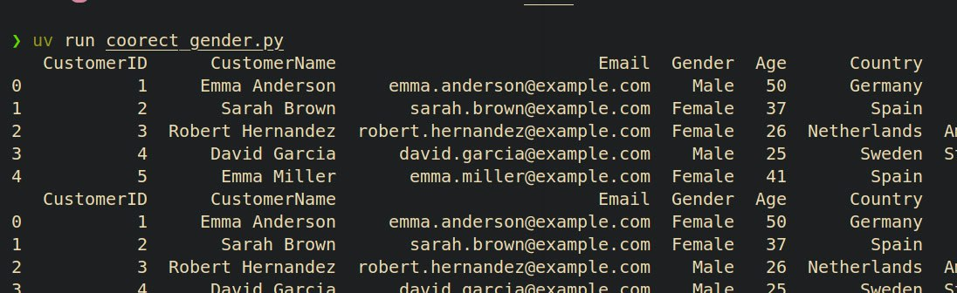
Gender correction
The result of running the script
Before
After

Slide 13
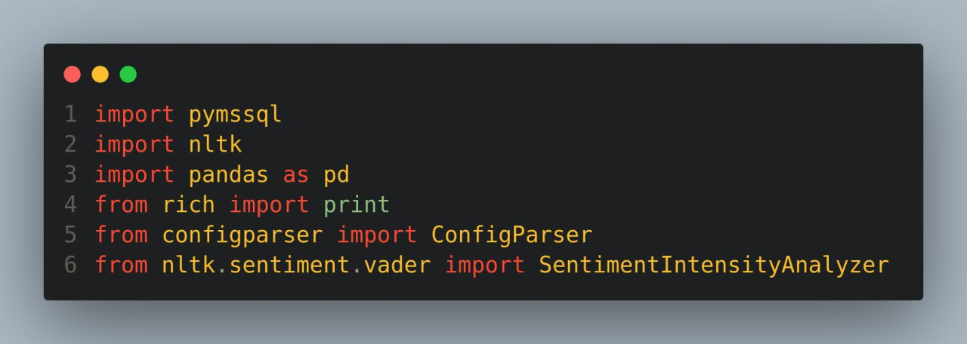
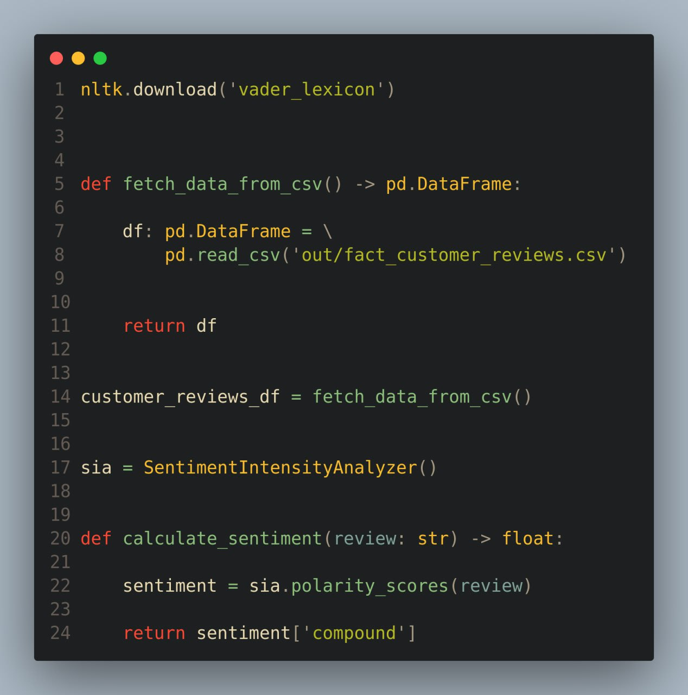
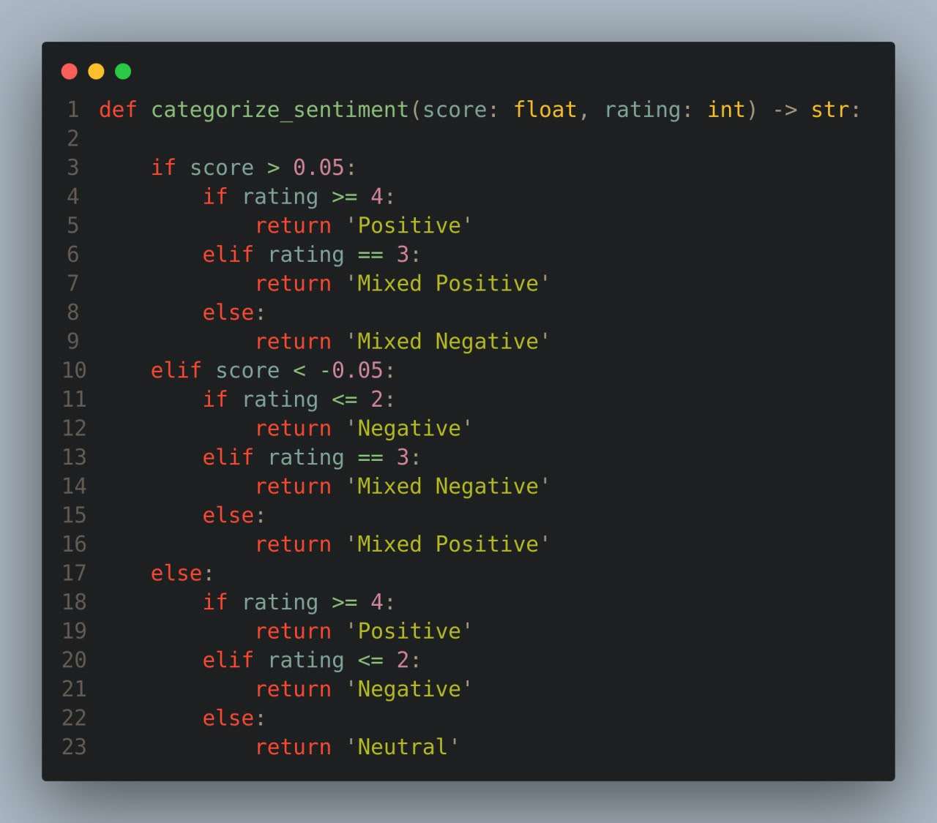
Customer reviews enrichment
Importing libraries (nltk – pandas – rich )
Downloading module (vader_lexicon) and function to load data and another func to calculate the score based on the model
Defining function to categorize the reviews sentiment based on the calculated score and the rating

Slide 14
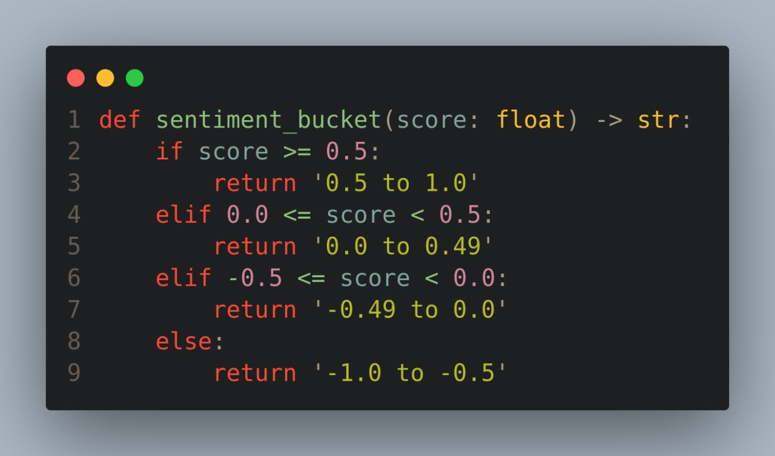
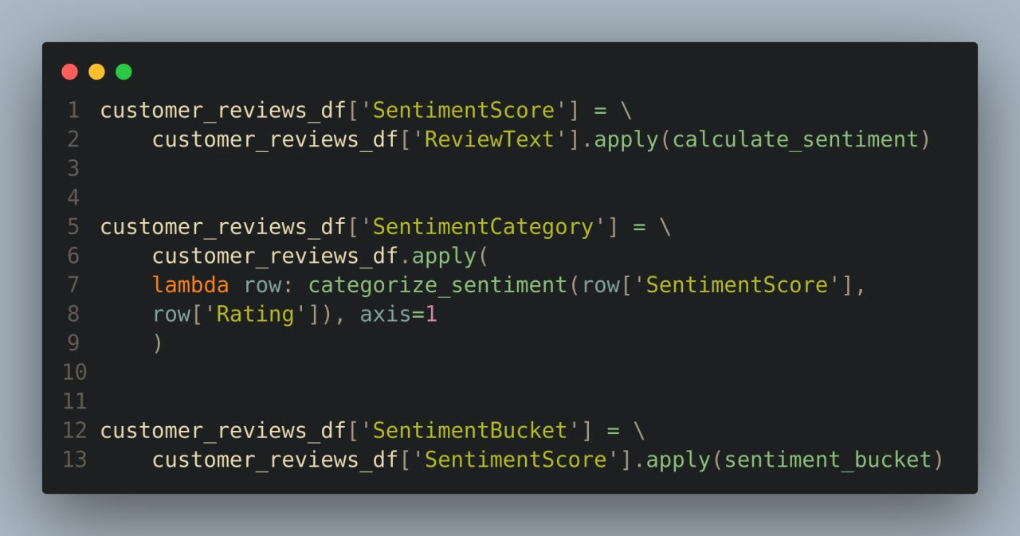
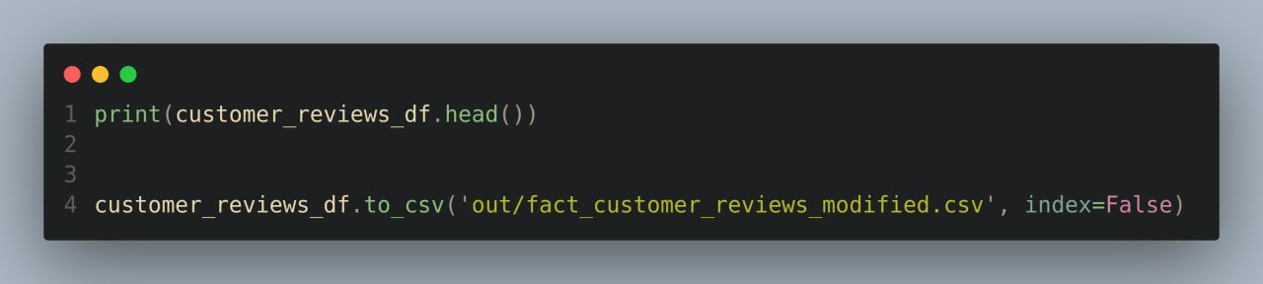
Customer reviews enrichment
Defining function to categorize the reviews sentiment based on the calculated score only
Evaluate the functions and store data in new columns
View the updated data and store it into a csv file

Slide 15
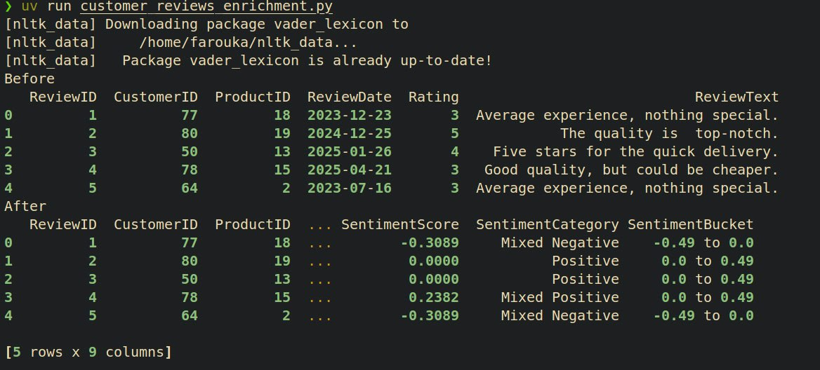
Customer reviews enrichment
Before
After

Slide 16
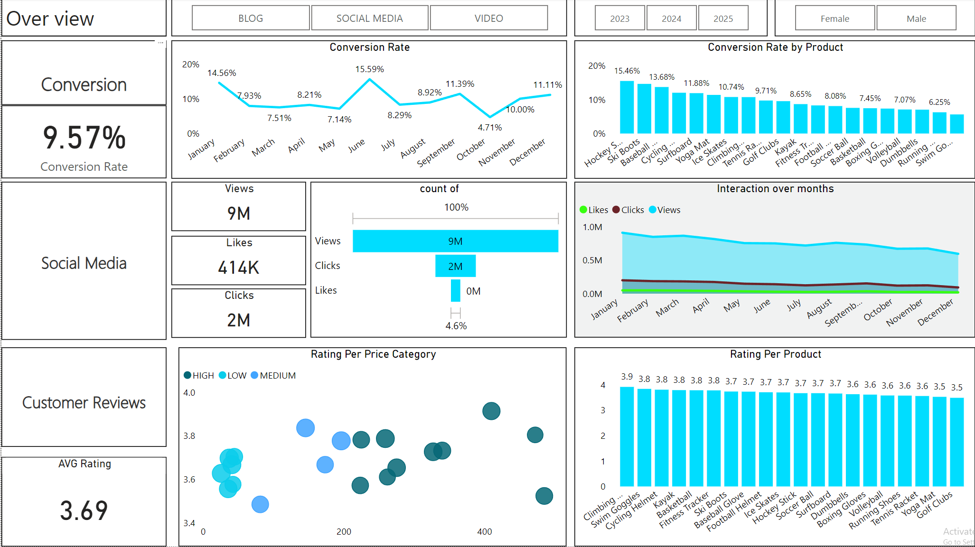
Overview dashboard

Slide 17
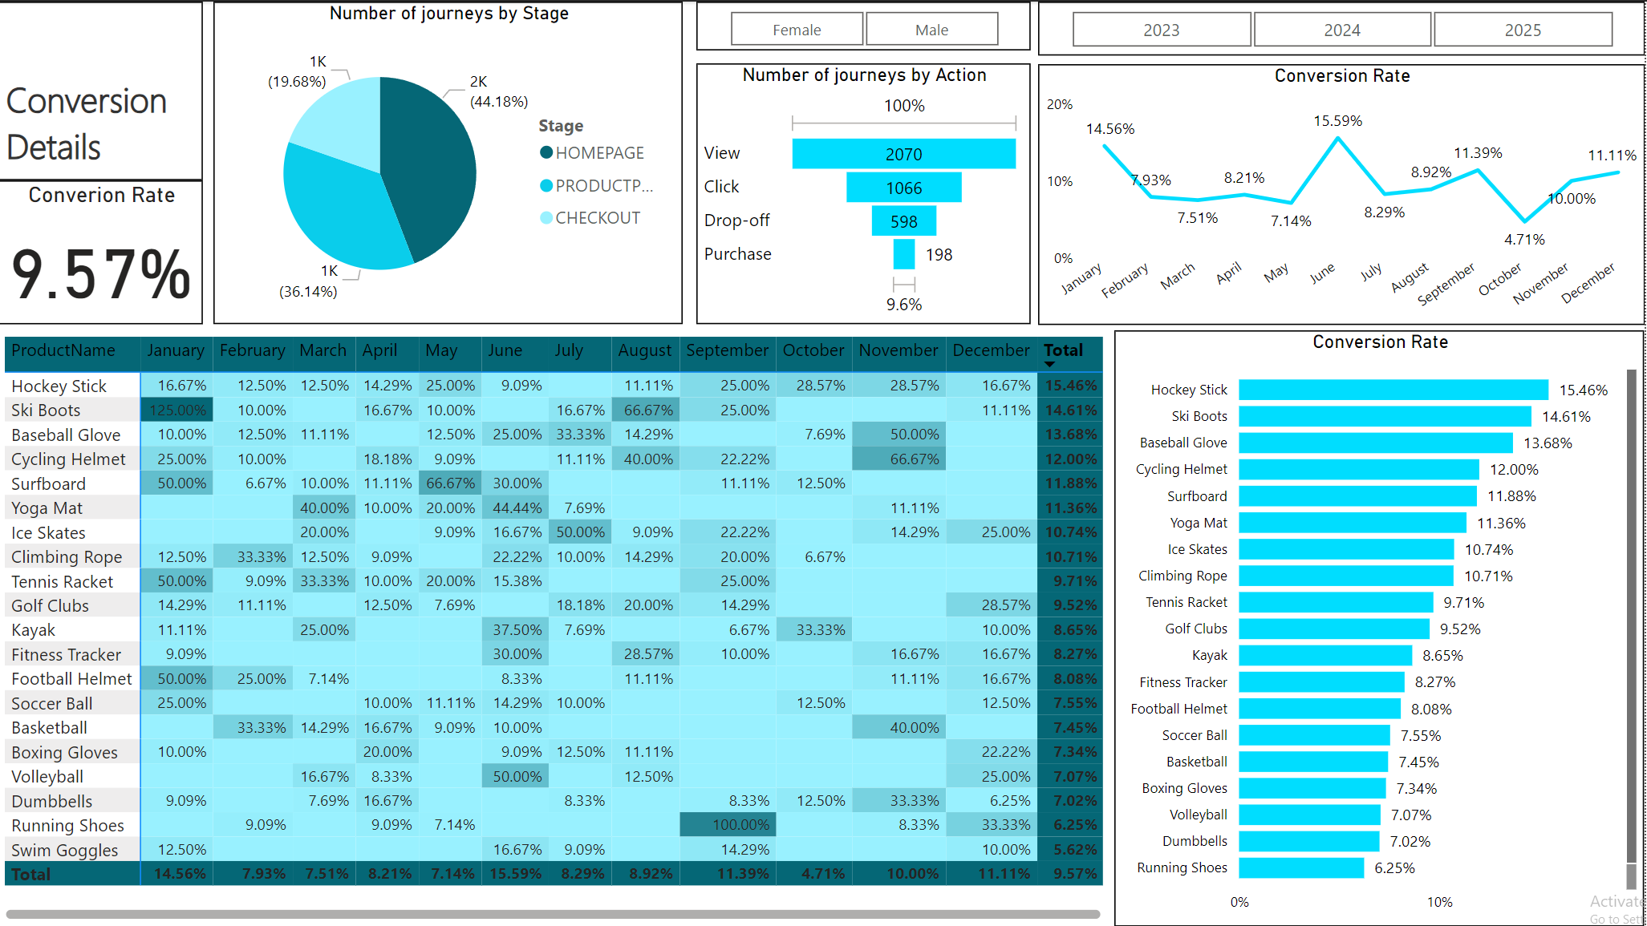
Conversion details dashboard

Slide 18
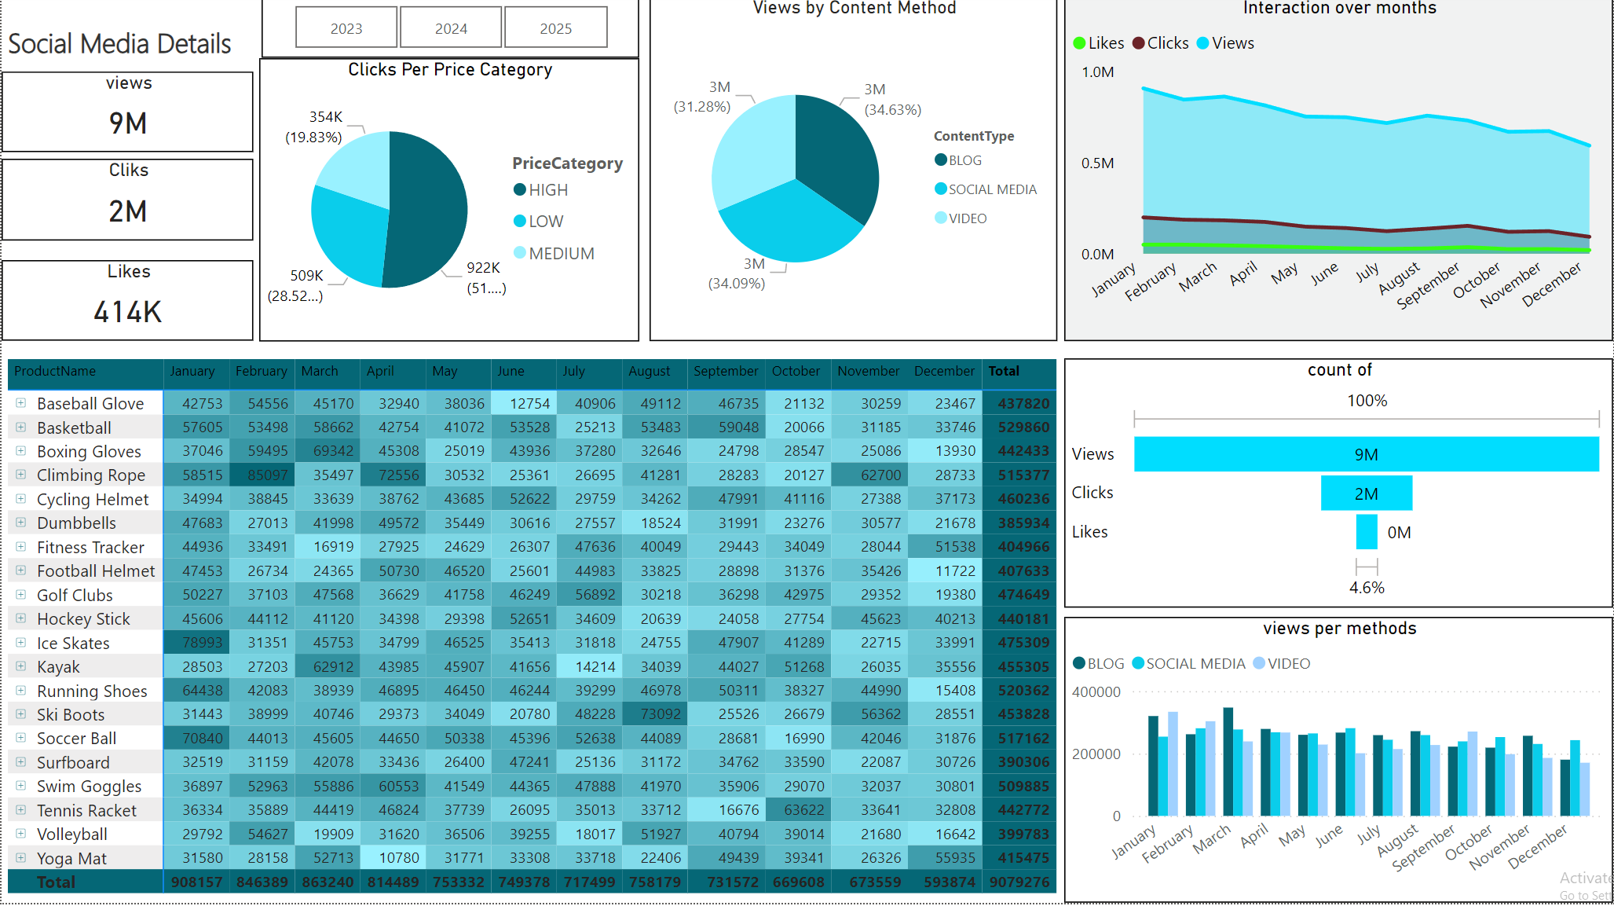
Social media details dashboard

Slide 19
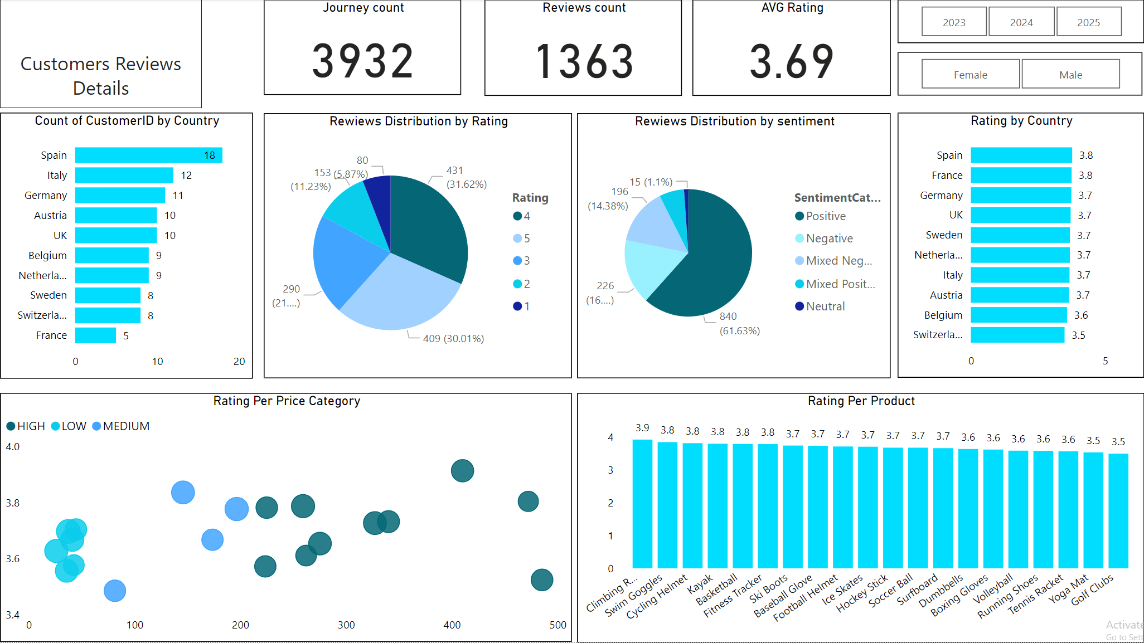
Customer reviews details dashboard

Slide 20
Insights Overview
Decreased Conversion Rates: The conversion rate demonstrated a strong rebound in December, reaching 10.2%, despite a notable dip to 5.0% in October.
Reduced Customer Engagement:
There is a decline in overall social media engagement, with views dropping throughout the year.
While clicks and likes are low compared to views, the click-through rate stands at 15.37%, meaning that engaged users are still interacting effectively.
Customer Feedback Analysis:
Customer ratings have remained consistent, averaging around 3.7 throughout the year.
Although stable, the average rating is below the target of 4.0, suggesting a need for focused improvements in customer satisfaction, for products below 3,5.

Slide 21
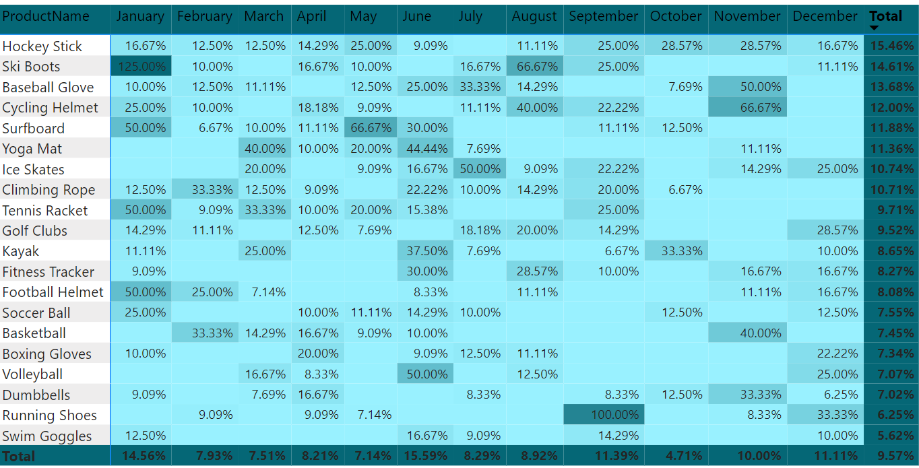
Insights Decreased Conversion Rates
General Conversion Trend:
Throughout the year, conversion rates varied, with higher numbers of products converting successfully in months like january and November . This suggests that while some products had strong seasonal peaks, there is potential to improve conversions in lower-performing months through targeted interventions.
Lowest Conversion Month:
october experienced the lowest overall conversion rate at 4.71%, with no products standing out significantly in terms of conversion. This indicates a potential need to revisit marketing strategies or promotions during this period to boost performance.
Highest Conversion Rates:
January recorded the highest overall conversion rate at 14.56%, driven significantly by the Ski Boots with a remarkable 125% conversion. This indicates a strong start to the year, likely fueled by seasonal demand and effective marketing strategies.

Slide 22
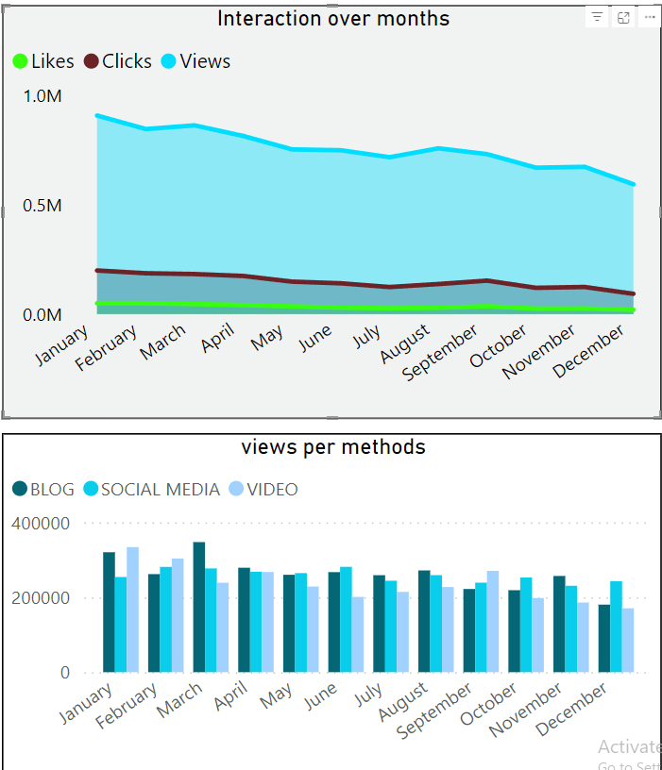
Insights Reduced Customer Engagement
Declining Views:
Views peaked in january and march but declined from April and on, indicating reduced audience engagement in the later two thired of the year.
Low Interaction Rates:
Clicks and likes remained consistently low compared to views, suggesting the need for more engaging content or stronger calls to action.
Content Type Performance:
Blog content drove the most views, especially in march , while social media and video content maintained steady but slightly lower engagement.

Slide 23
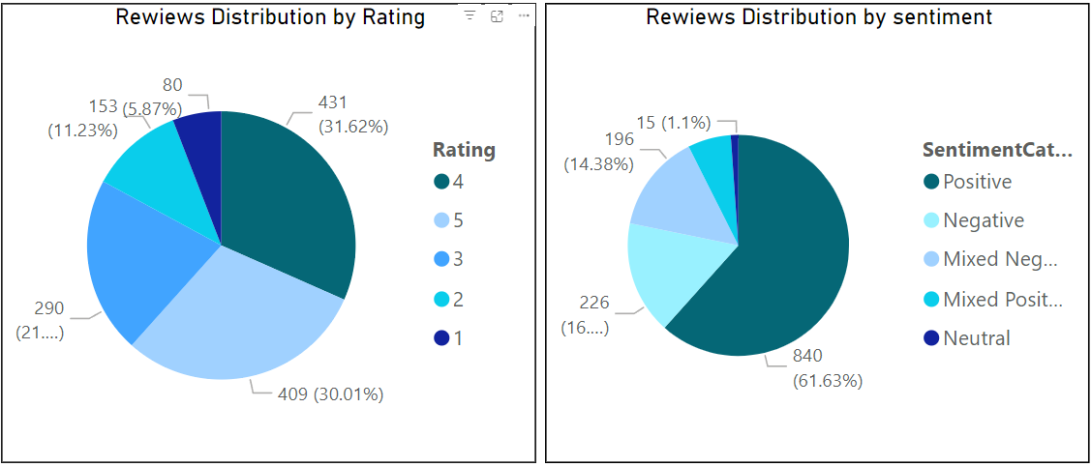
Insights Customer Feedback Analysis
Customer Ratings Distribution:
The majority of customer reviews are in the higher ratings, with 431 reviews at 4 stars and 409 reviews at 5 stars, indicating overall positive feedback. Lower ratings (1-2 stars) account for a smaller proportion, with 80 reviews at 1 star and 153 reviews at 2 stars.
Sentiment Analysis:
Positive sentiment dominates with 840 reviews, reflecting a generally satisfied customer base. Negative sentiment is present in 226 reviews, with a smaller number of mixed and neutral sentiments, suggesting some areas for improvement but overall strong customer approval.
Opportunity for Improvement:
The presence of mixed positive and mixed negative sentiments suggests that there are opportunities to convert those mixed experiences into more clearly positive ones, potentially boosting overall ratings. Addressing the specific concerns in mixed reviews could elevate customer satisfaction.

Slide 24
Goals & Actions
Goals
Actions
Increase Conversion Rates:
Goal: Identify factors impacting the conversion rate and provide recommendations to improve it.
Insight: Highlight key stages where visitors drop off and suggest improvements to optimize the conversion funnel.
Enhance Customer Engagement:
Goal: Determine which types of content drive the highest engagement.
Insight: Analyze interaction levels with different types of marketing content to inform better content strategies.
Improve Customer Feedback Scores:
Goal: Understand common themes in customer reviews and provide actionable insights.
Insight: Identify recurring positive and negative feedback to guide product and service improvements.
Increase Conversion Rates:
Target High-Performing Product Categories: Focus marketing efforts on products with demonstrated high conversion rates, such as Kayaks, Ski Boots, and Baseball Gloves. Implement seasonal promotions or personalized campaigns during peak months (e.g., January and September) to capitalize on these trends.
Enhance Customer Engagement:
Revitalize Content Strategy: To turn around declining views and low interaction rates, experiment with more engaging content formats, such as interactive videos or user-generated content. Additionally, boost engagement by optimizing call-to-action placement in social media and blog content, particularly during historically lower-engagement months (September-December).
Improve Customer Feedback Scores:
Address Mixed and Negative Feedback: Implement a feedback loop where mixed and negative reviews are analyzed to identify common issues. Develop improvement plans to address these concerns. Consider following up with dissatisfied customers to resolve issues and encourage re-rating, aiming to move average ratings closer to the 4.0 target.

Slide 25
Any Question ?

Slide 26
Thank you

